Slide 1





DocRater
Home
About Us
Service
Contact
The Smart Bridge to Your Perfect Doctor.
DocRater
DocRater Your Healthcare Compass
Discover trusted doctors tailored to your needs. With DocRater, personalized care is just a tap away. Empowering you to make informed healthcare decisions.
NEXT
DocRater

Slide 2
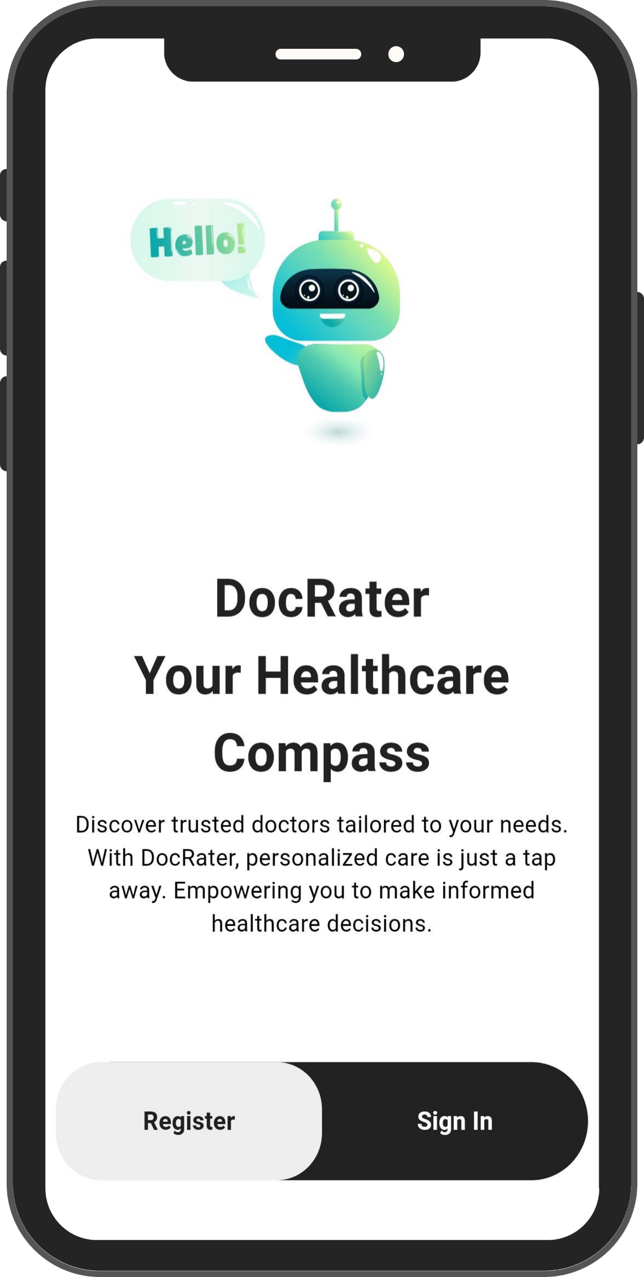
DocRater
The Smart Bridge to Your Perfect Doctor.
Presented by:
Instructor:
Name: Asif Ahamed Student
ID: 223311112
Name: Hafijur Rahman Hemel
ID: 223311254
Course Title: Software Development Lab II
Course Code: CSE 236
Semester: 4th
Group: C-2
Abdullah Tamim
Lecturer (Contractual)
Department of CSE
Varendra University, Rajshahi

Slide 3




Project Overview
DocRater
Finding reliable and trustworthy healthcare providers can be a daunting task.
Empowering patients to make informed decisions when selecting healthcare professionals.
1

Slide 4





Tech Stack
DocRater
Flutter for cross-platform development.
Flutter
Firebase for backend and authentication services
Firebase
2

Slide 5
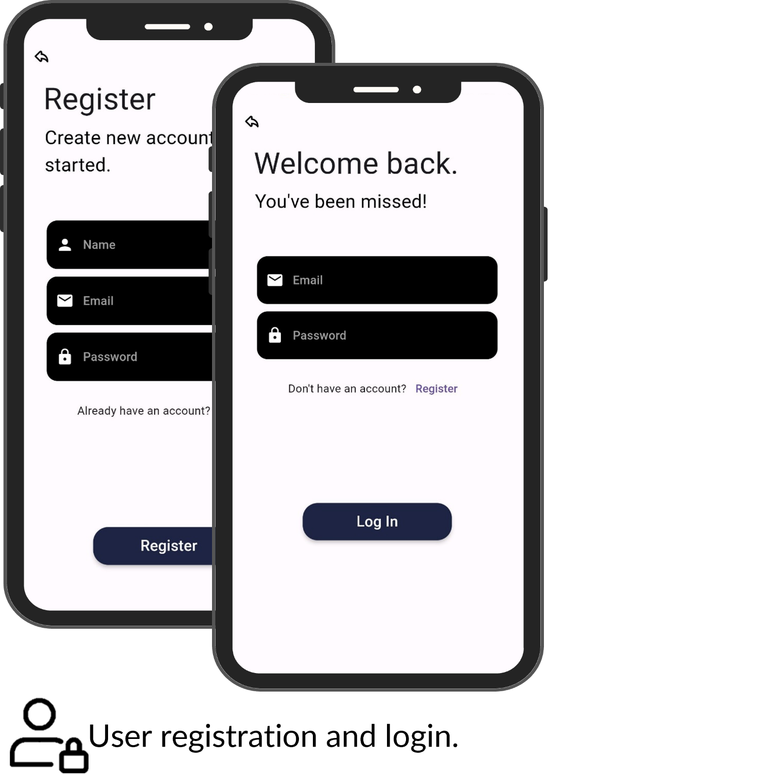
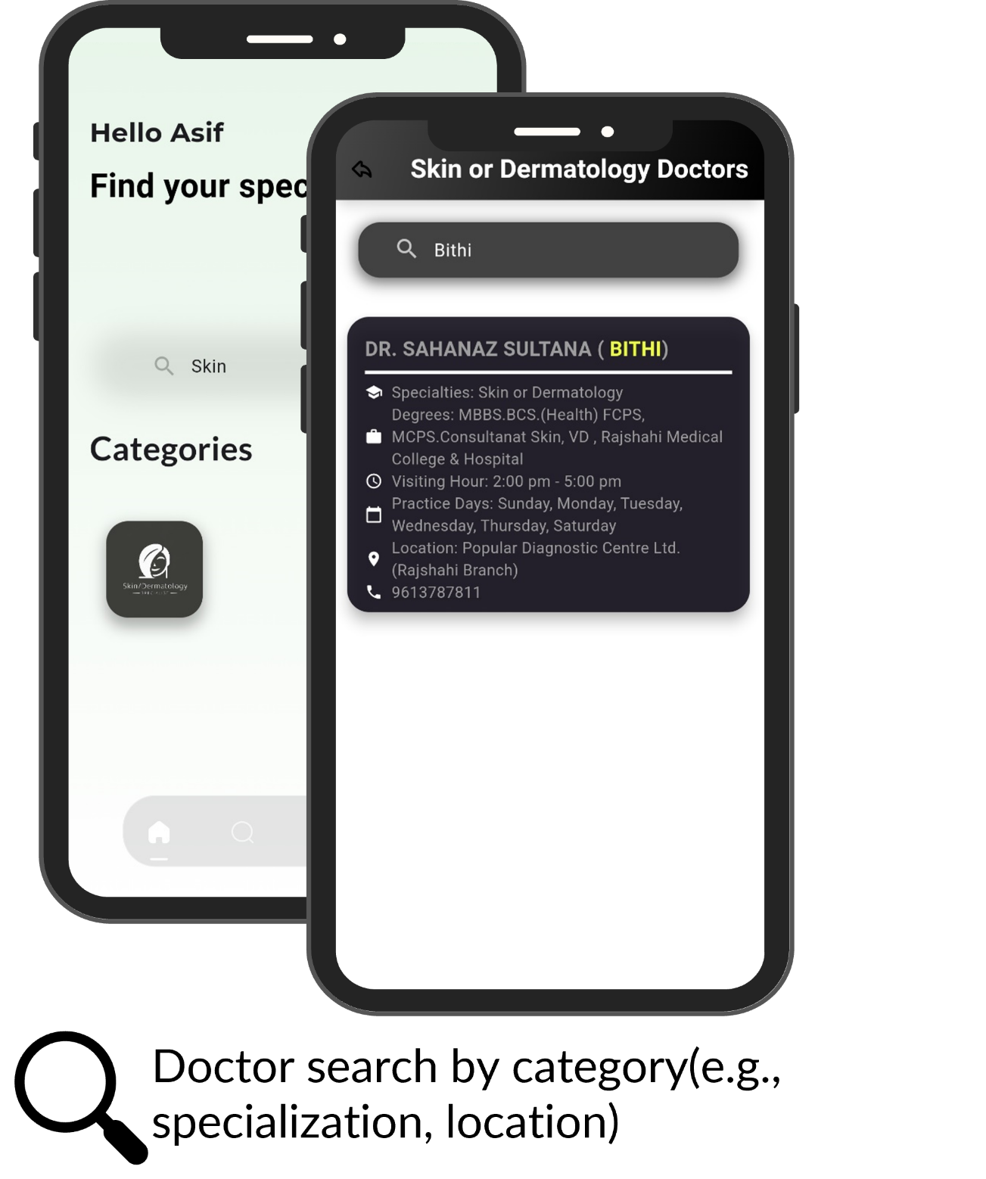
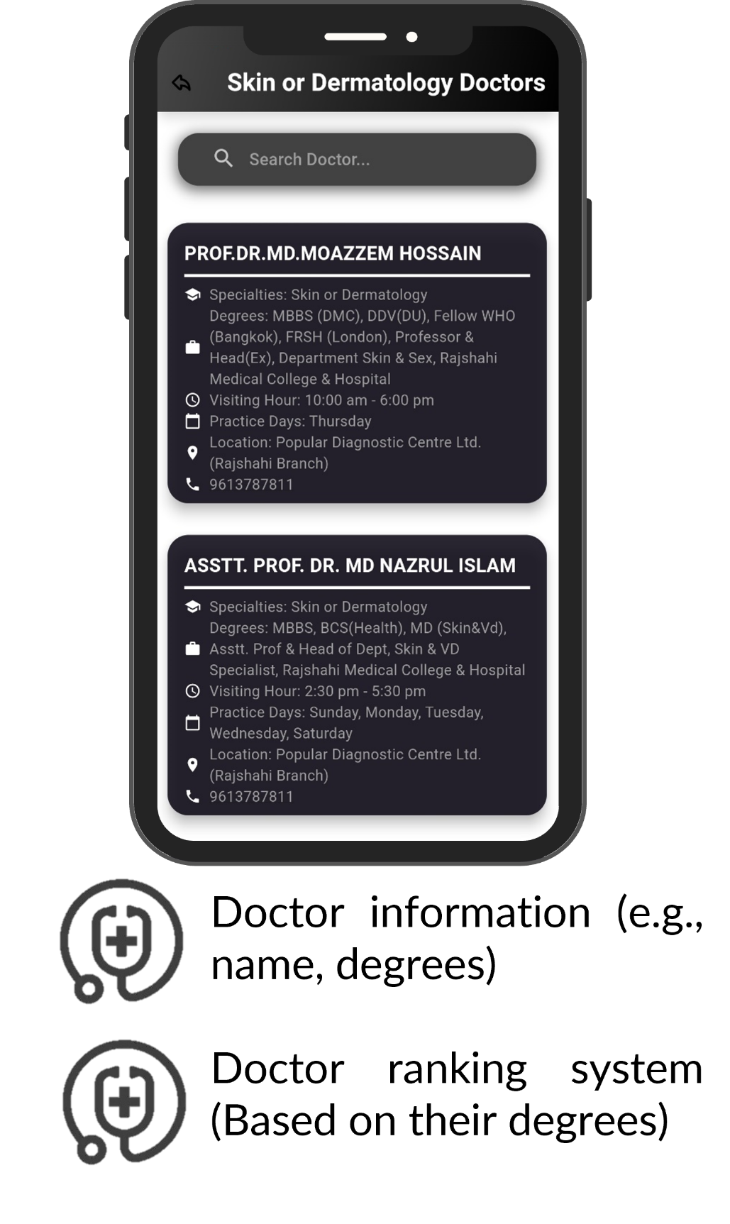

App Features
DocRater
3

Slide 6

User Authentication
DocRater
Firebase Authentication to ensure a secure sign-up and login process.
Firebase
4

Slide 7
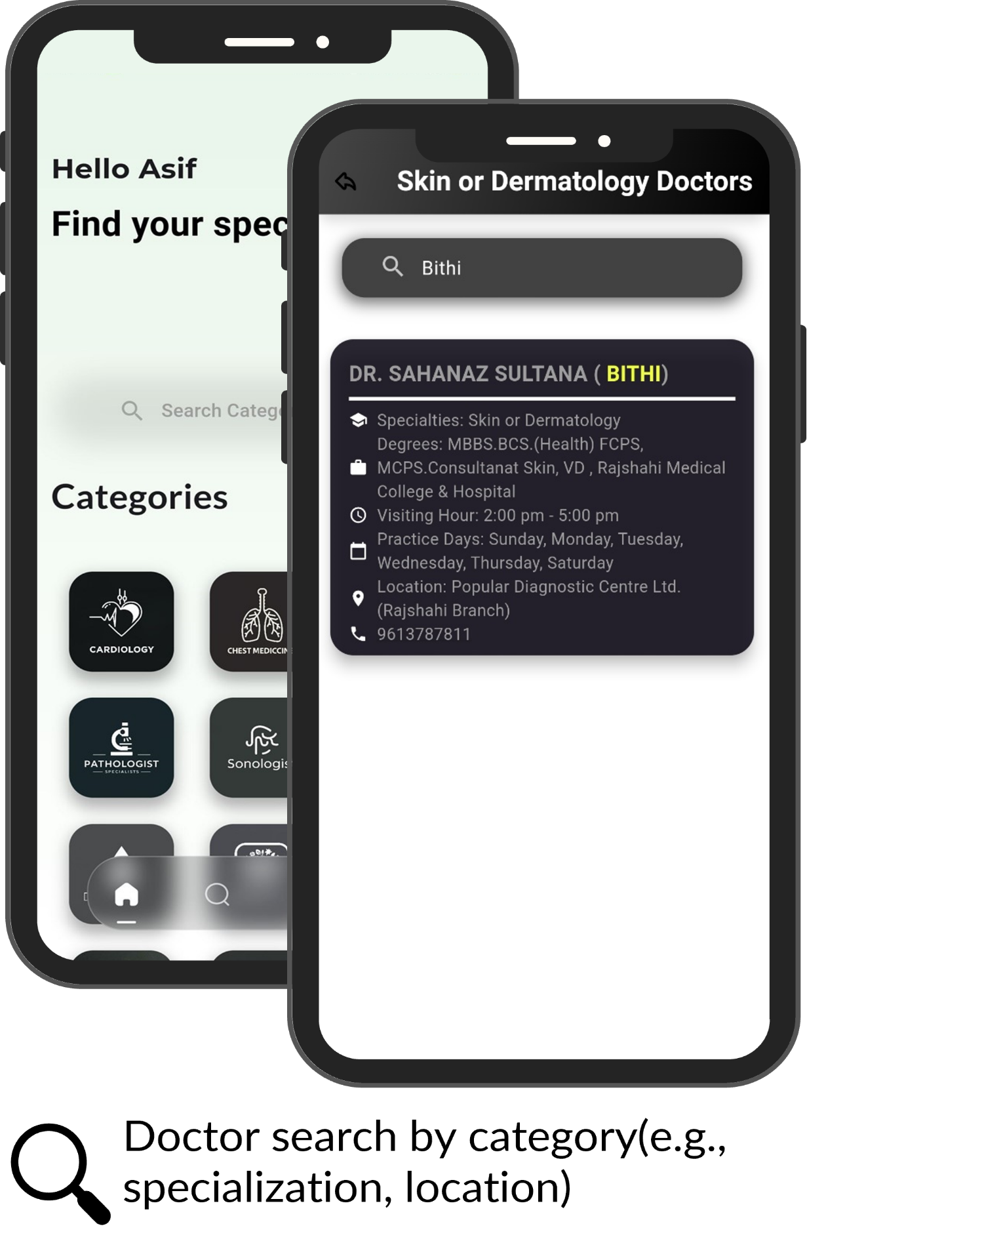

Doctor Search and Categories
DocRater
Organizing doctors into intuitive categories is essential for efficient search and discovery.
5

Slide 8
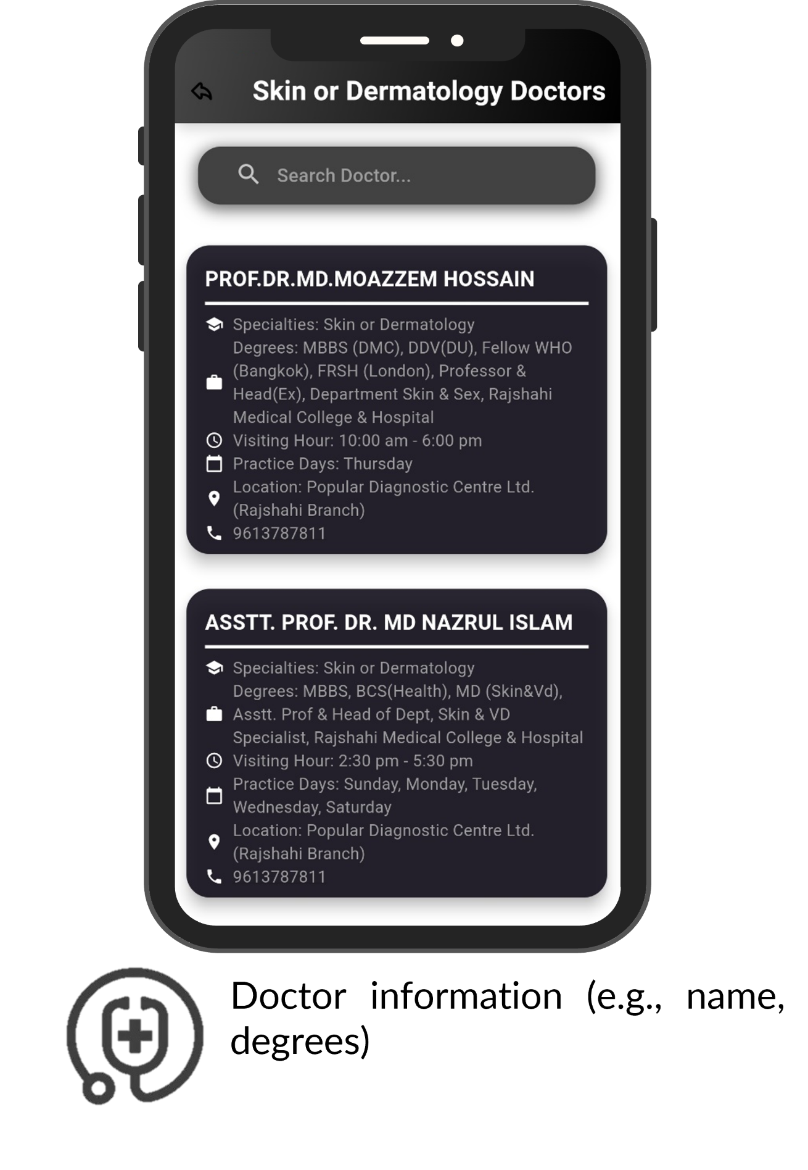

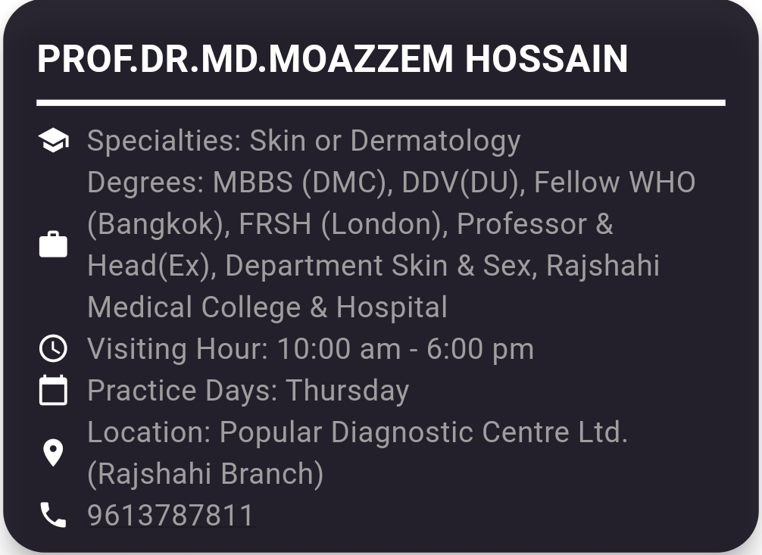
Doctor Profiles
DocRater
Doctor profiles are the heart of DocRater.
6

Slide 9
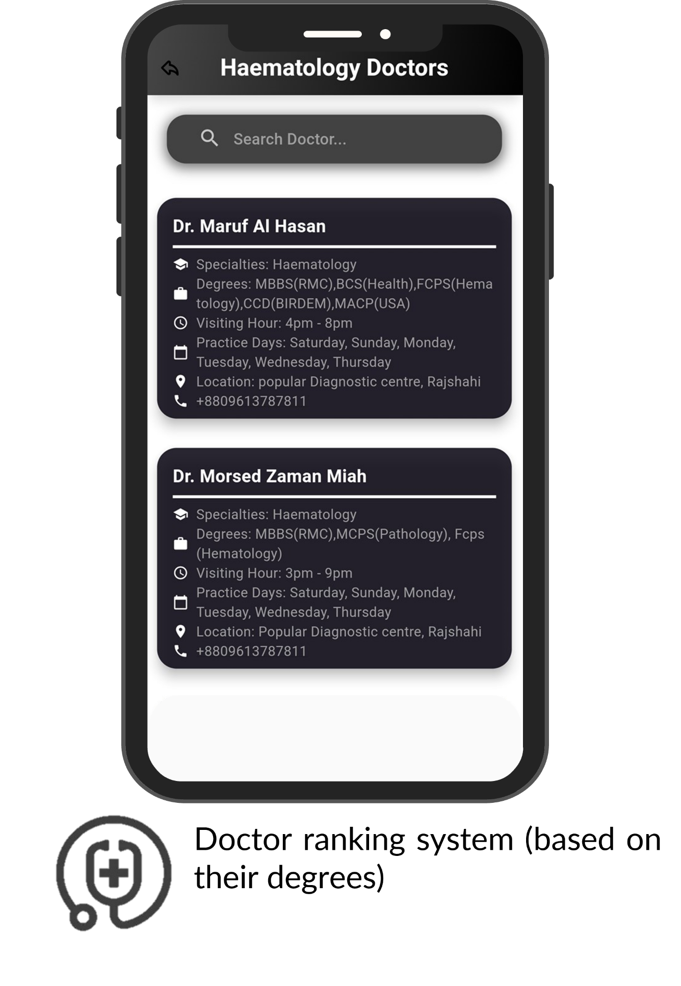

Doctor Ranking
DocRater
Sorting the list of doctors based on their degrees.
7

Slide 10
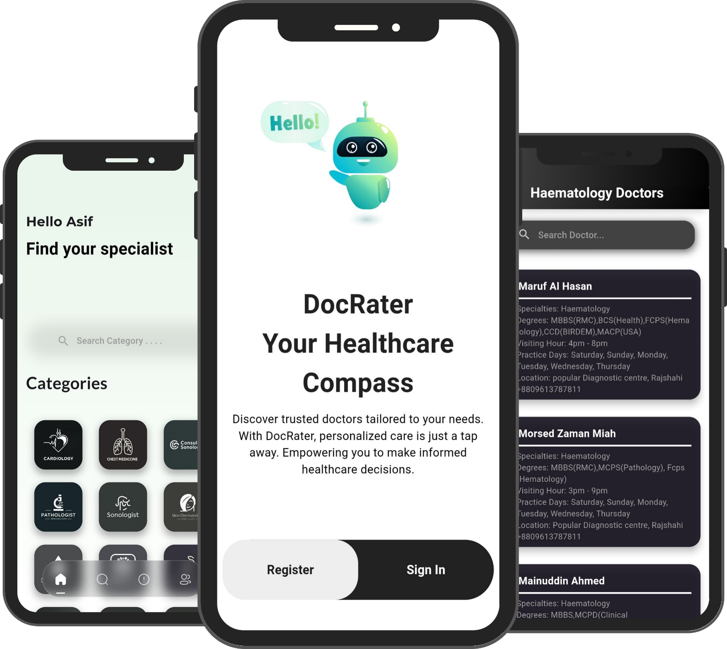
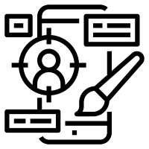
v
UI/UX Design
DocRater
Flutter's UI components were used to create an attractive and user-friendly interface.
8

Slide 11



Challenges and Learnings
DocRater
Challenges
Learnings
Future Plan
Faced many challenges when integrating Firebase services and optimizing the ranking algorithm.
we have gained invaluable experience in mobile app development.
Improve DocRater by introducing new features and addressing user feedback.
9

Slide 12
THANK YOU

